Slide 1
Data Analysis of Each Category

Slide 2
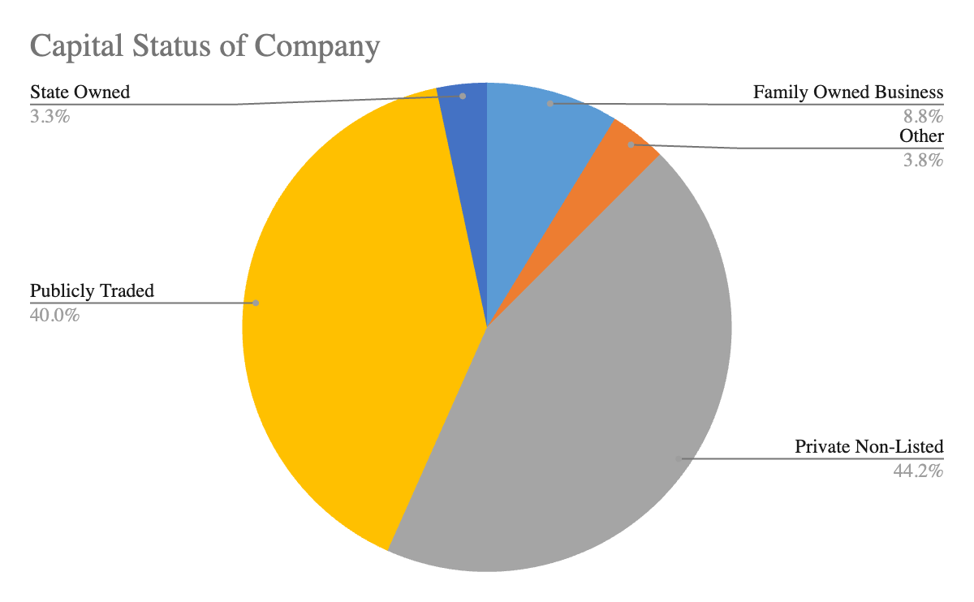
Capital Status of Company

Slide 3
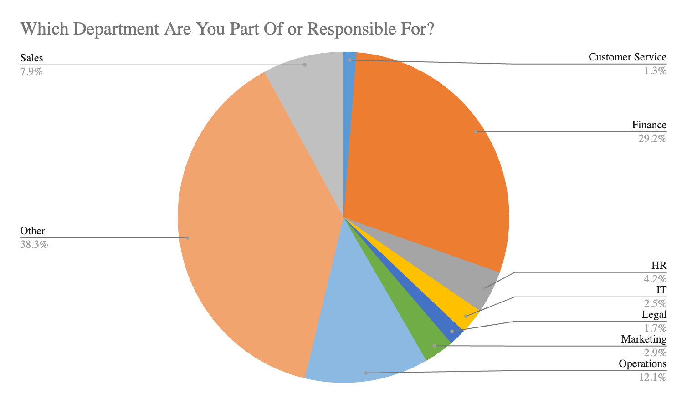
Department that the Respondent Belongs to

Slide 4
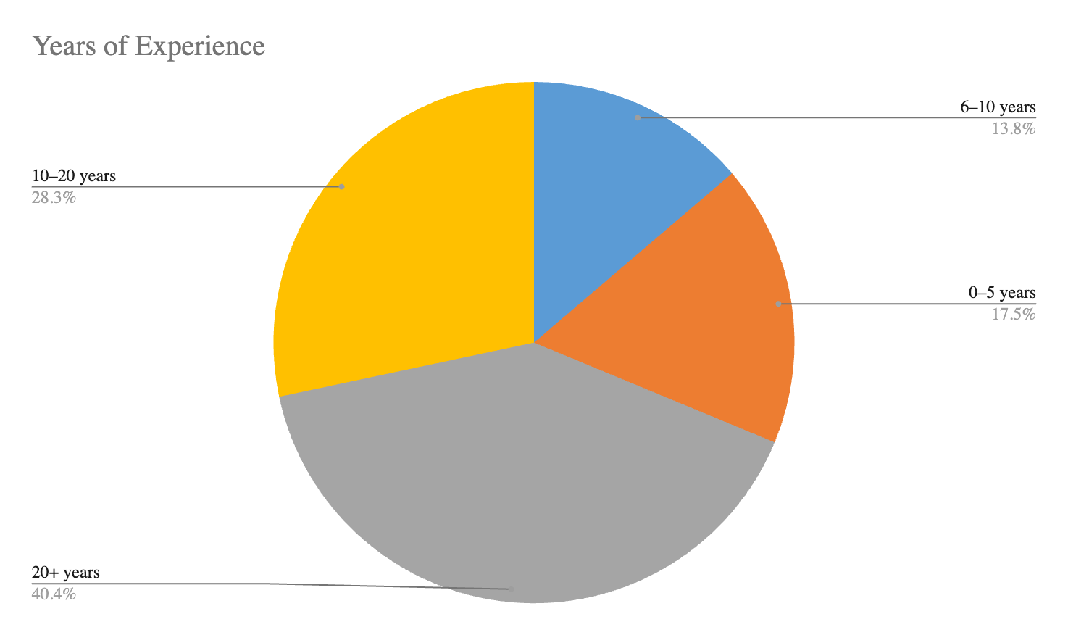
Years of Experience that the Respondent have

Slide 5
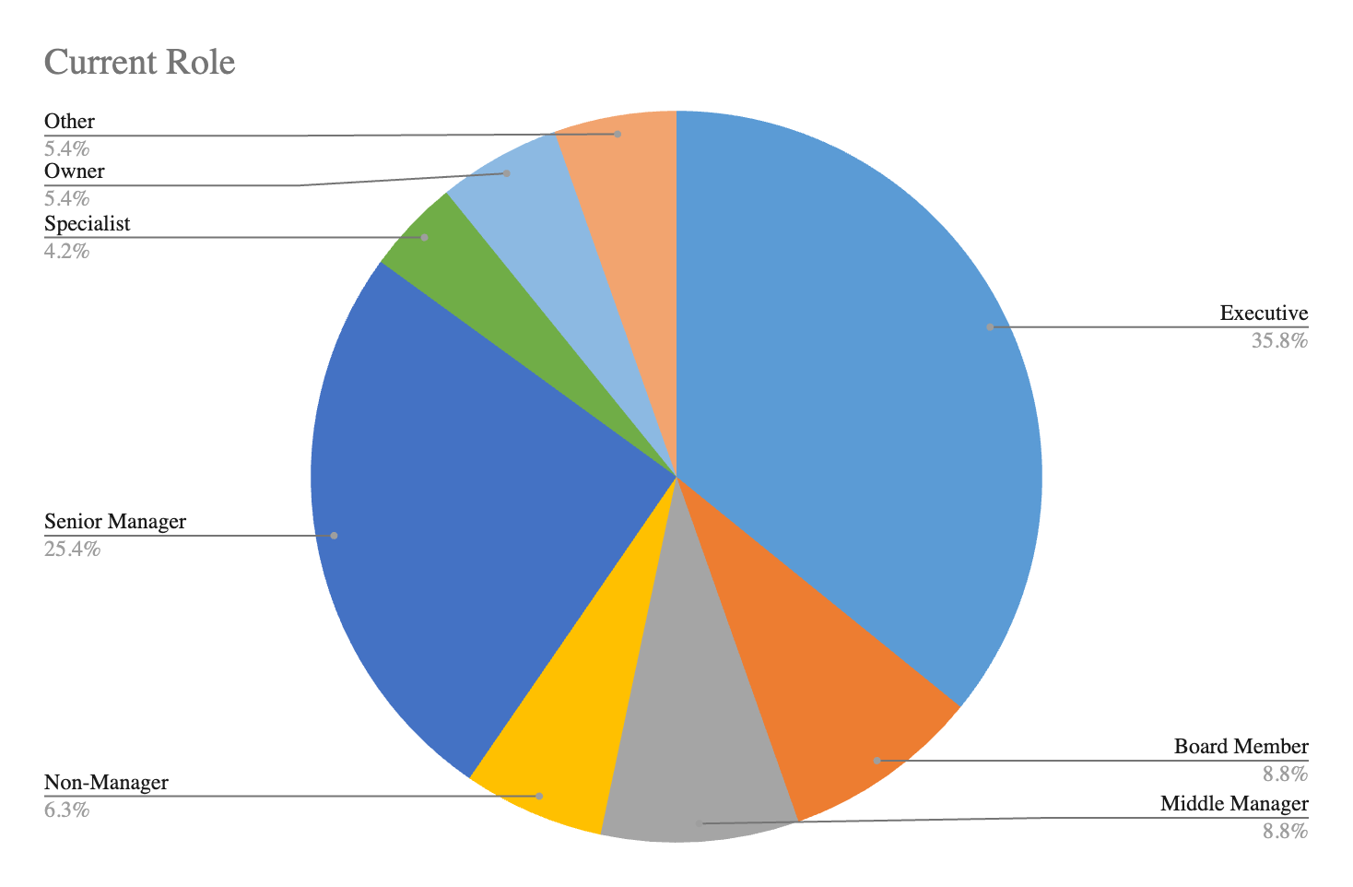
Current Role of the Respondents in their Organisation

Slide 6
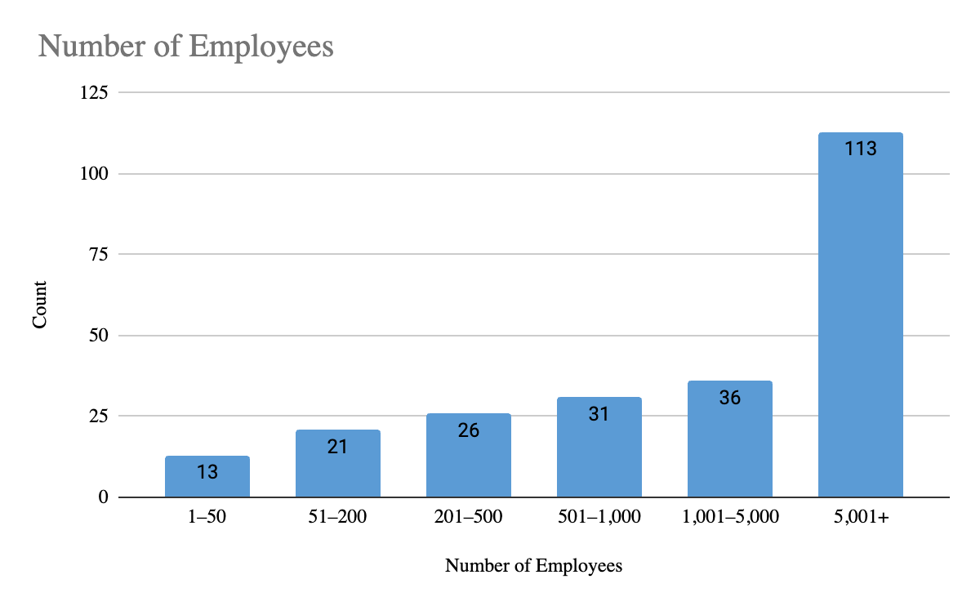
Number of Employees the Respondents Organization Have

Slide 7
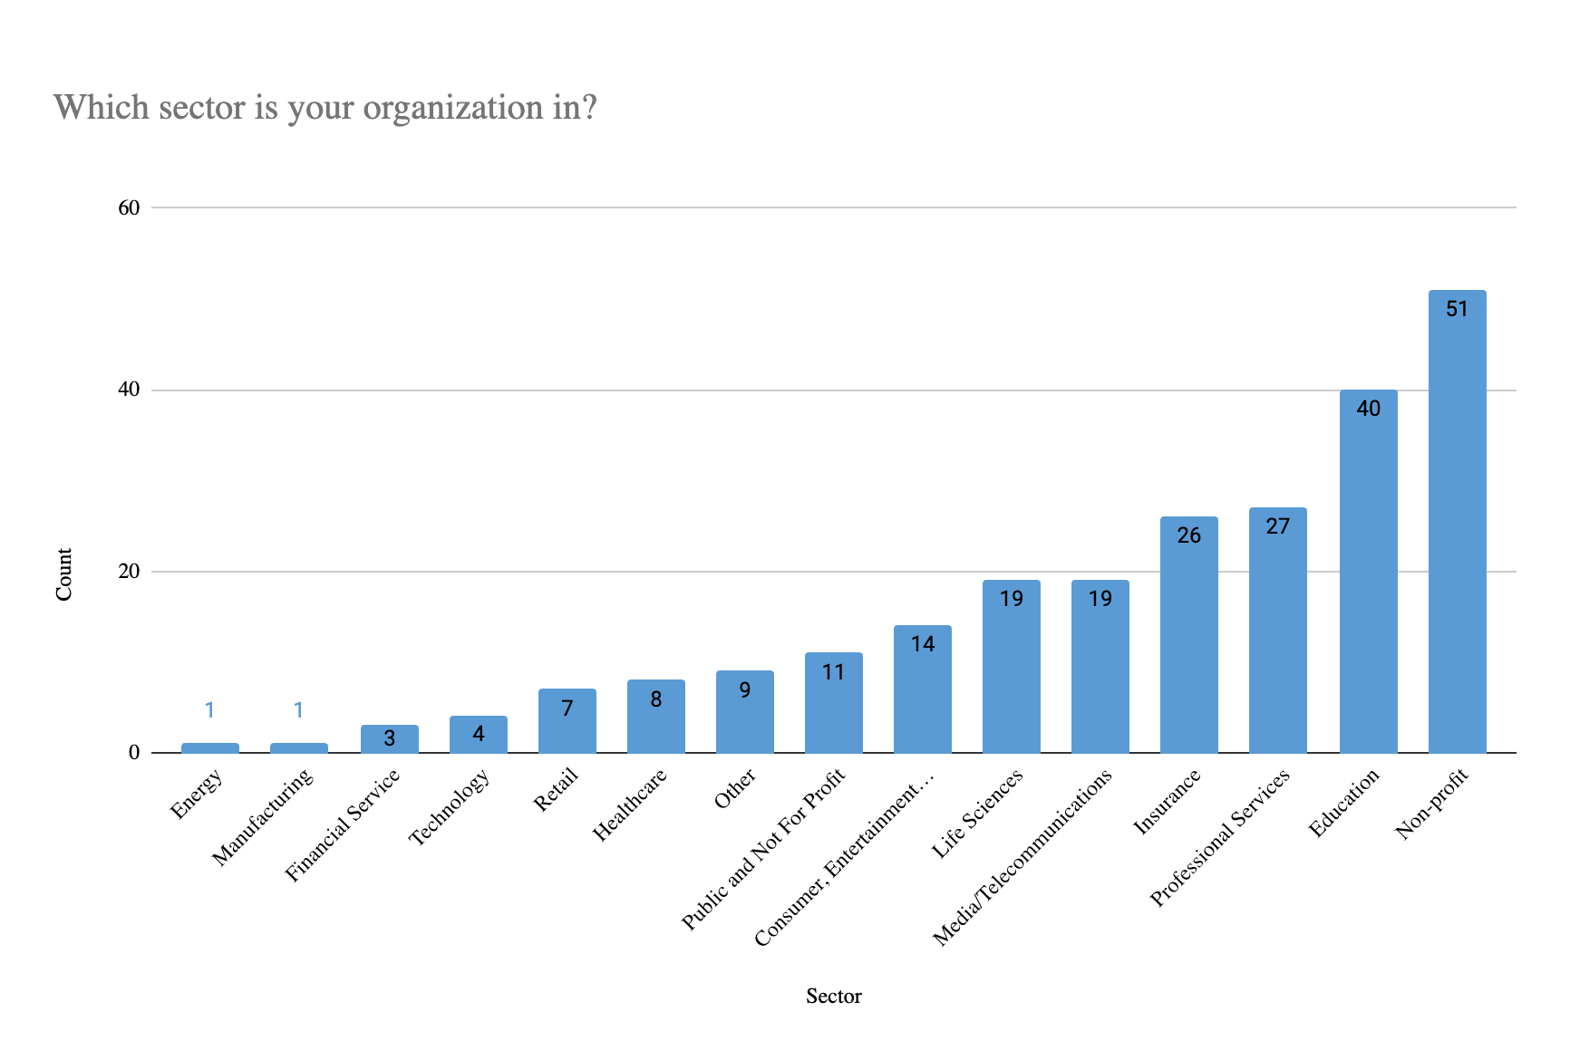
Particular sector that the Respondents Organisation Work In

Slide 8
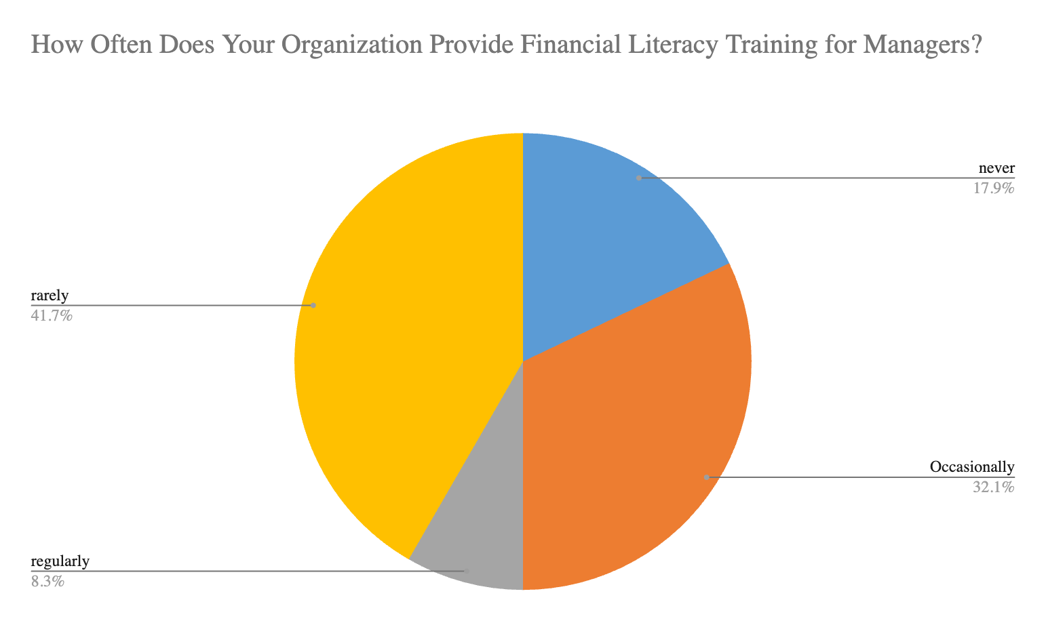
How Often Does Your Organization Provide Financial Literacy Training for Managers?

Slide 9
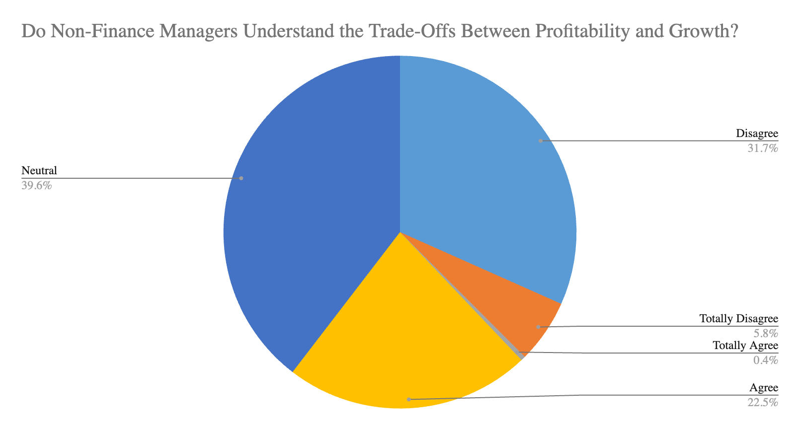
Do Non-Finance Managers Understand the Trade-Offs Between Profitability and Growth?

Slide 10
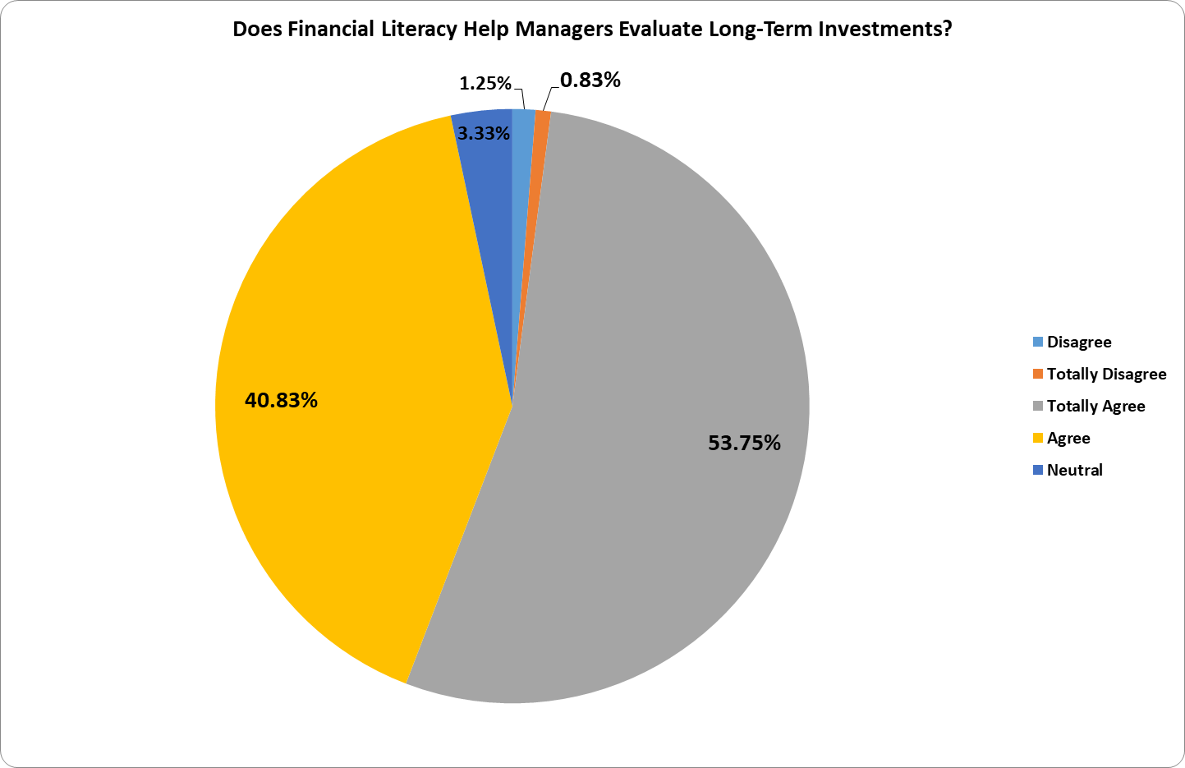
Does Financial Literacy Help Managers Evaluate Long-Term Investments?

Slide 11
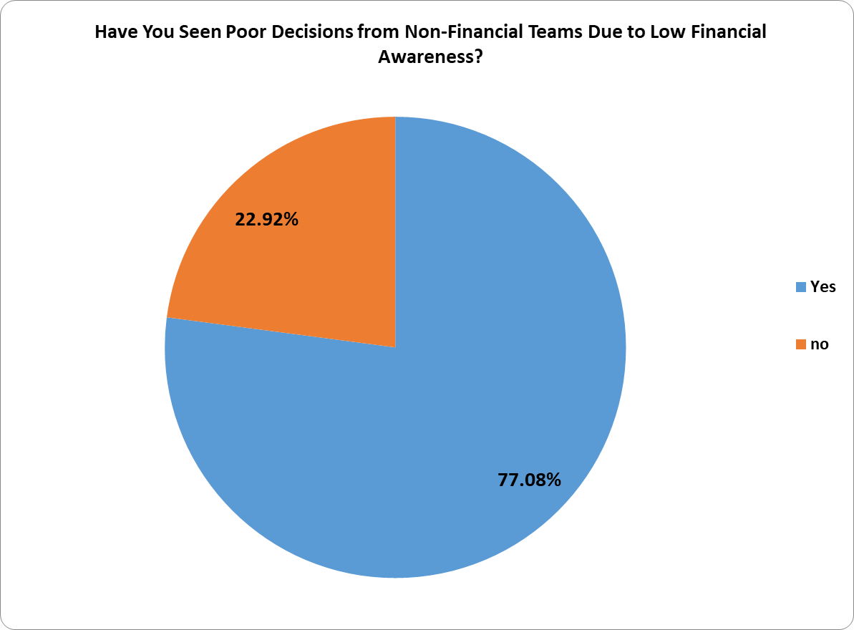
Have You Seen Poor Decisions from Non-Financial Teams Due to Low Financial Awareness?

Slide 12
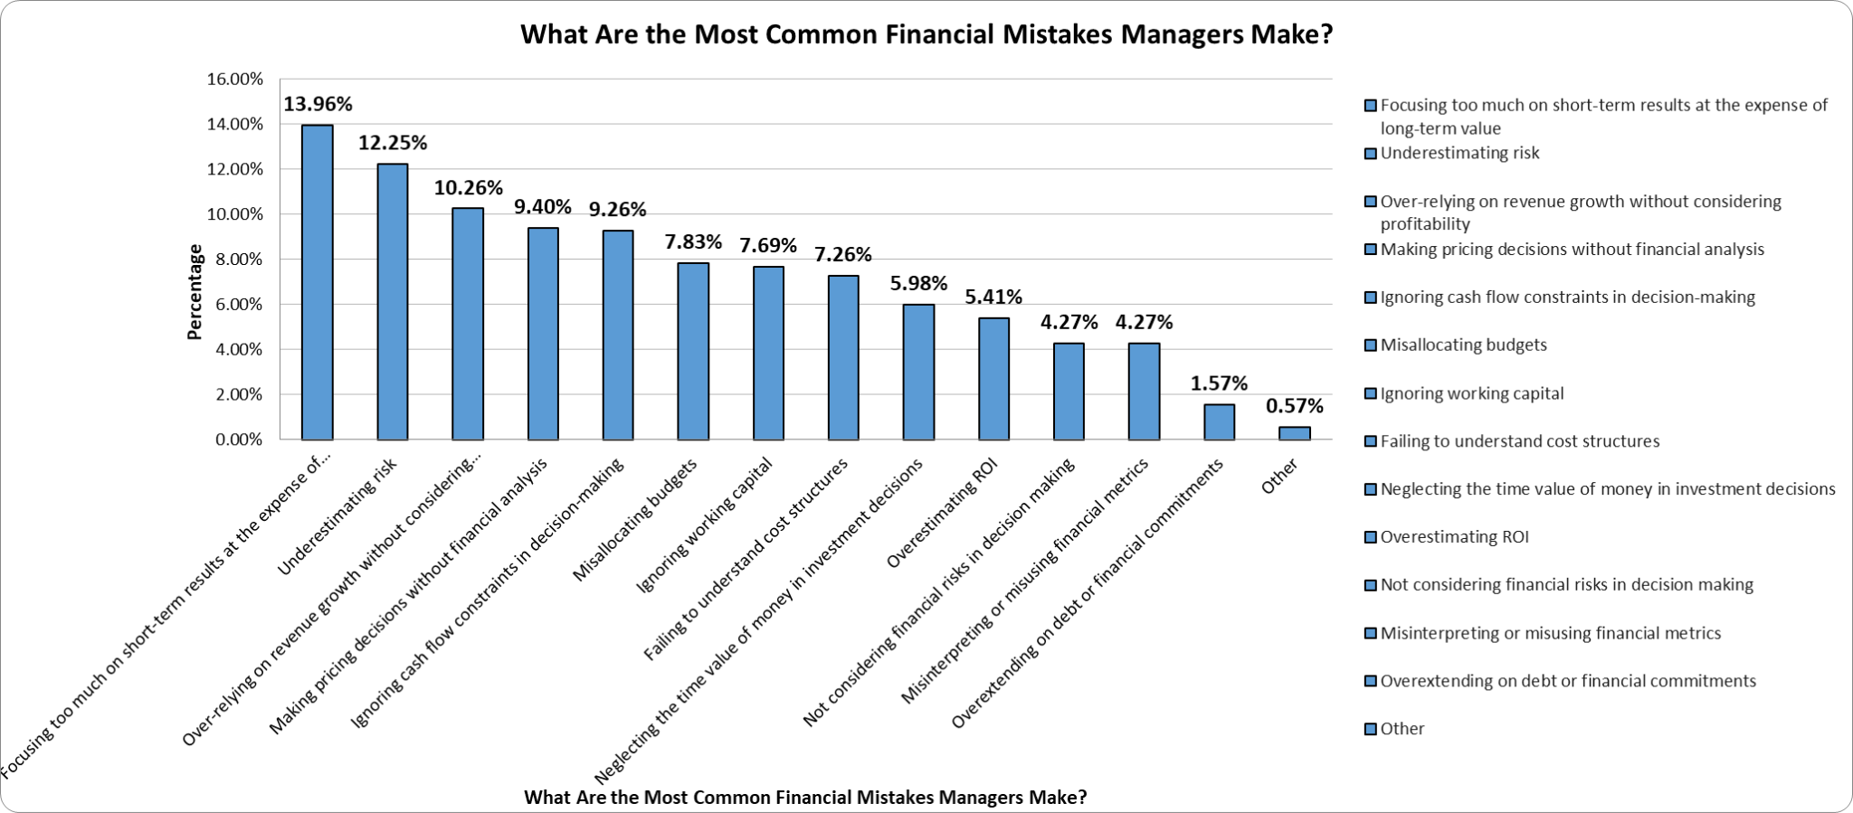
What Are the Most Common Financial Mistakes Managers Make?

Slide 13
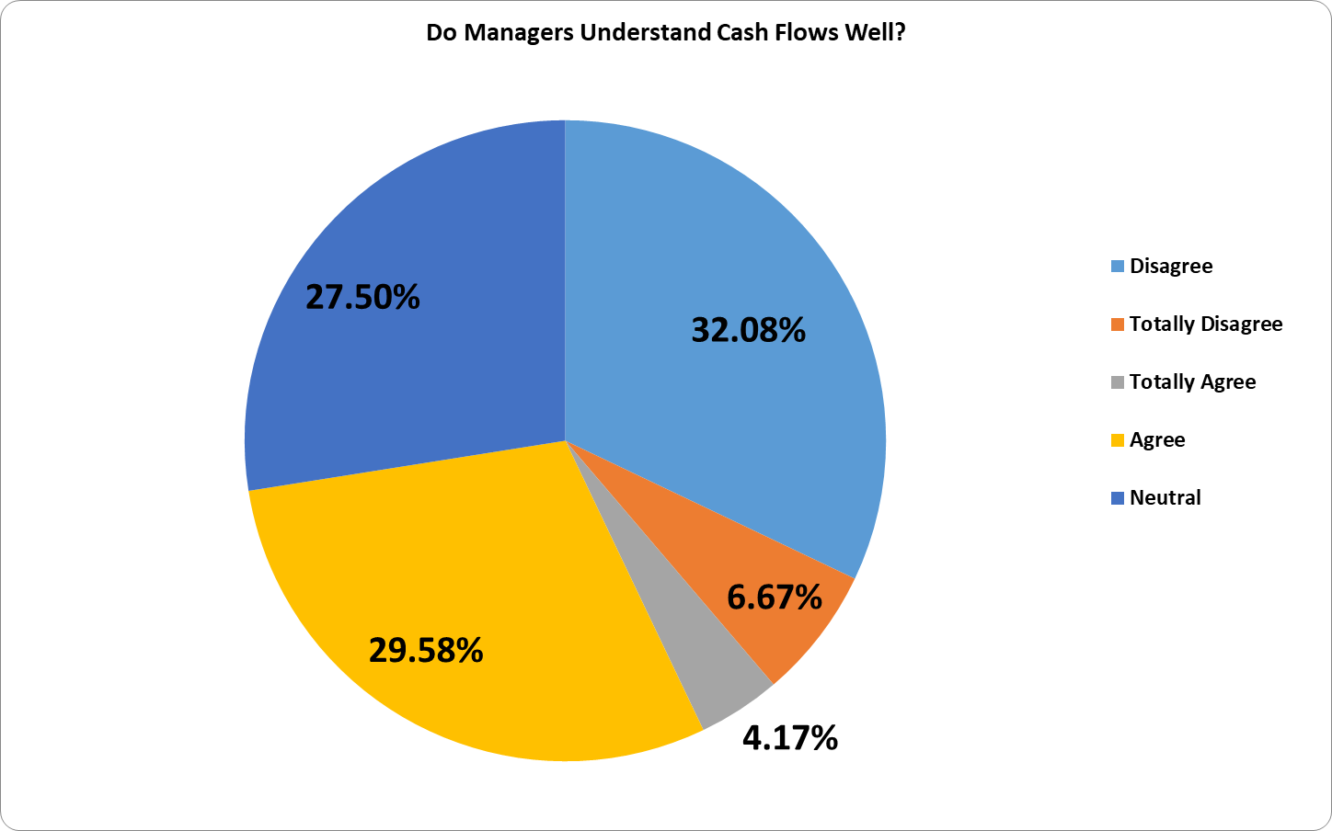
Do Managers Understand Cash Flows Well?

Slide 14
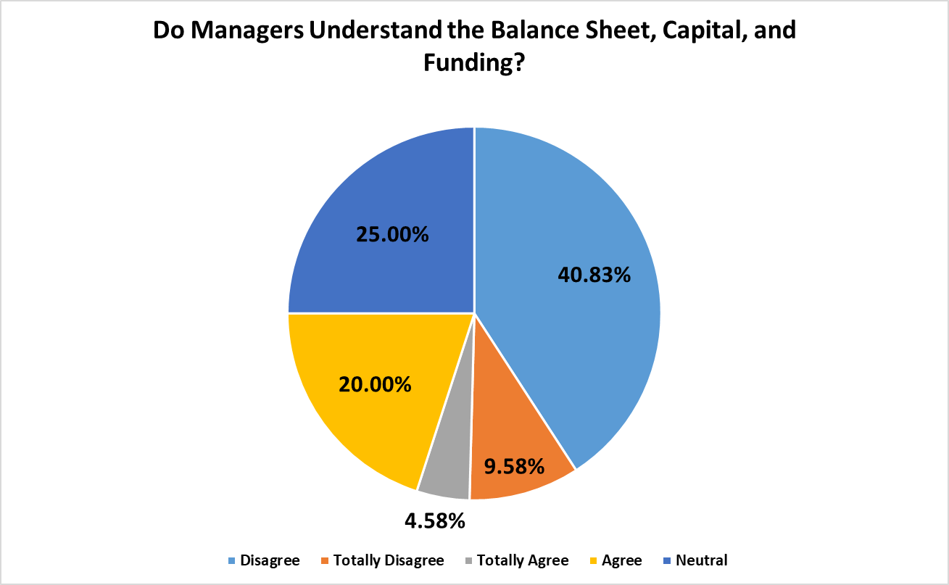
Do Managers Understand the Balance Sheet, Capital, and Funding?

Slide 15
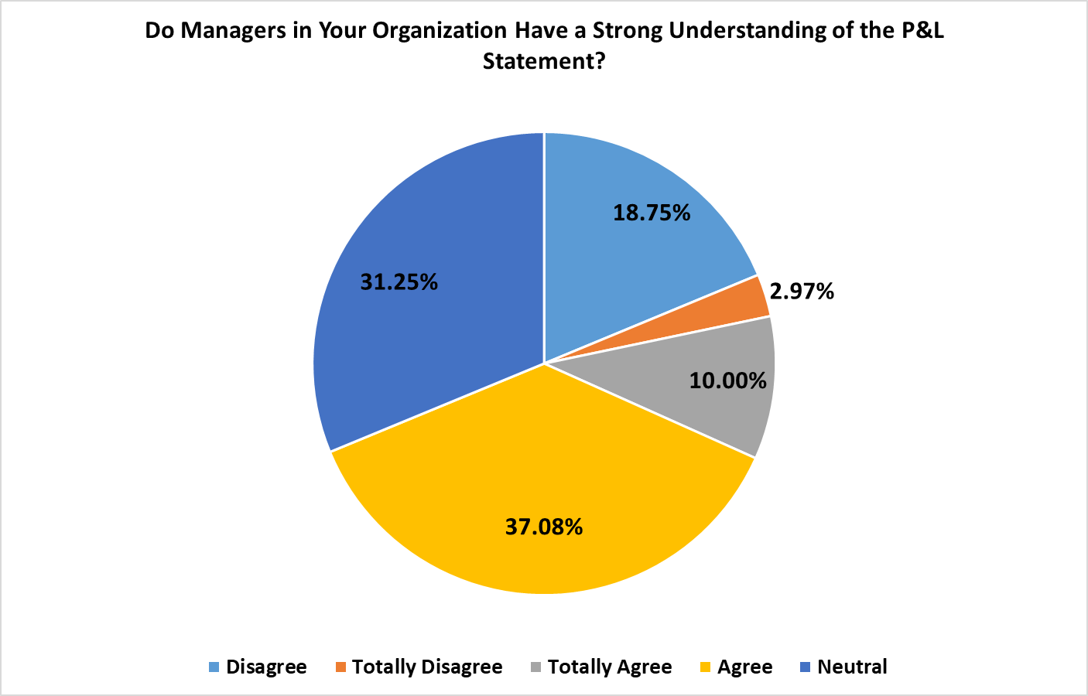
Do Managers in Your Organization Have a Strong Understanding of the P&L Statement?

Slide 16
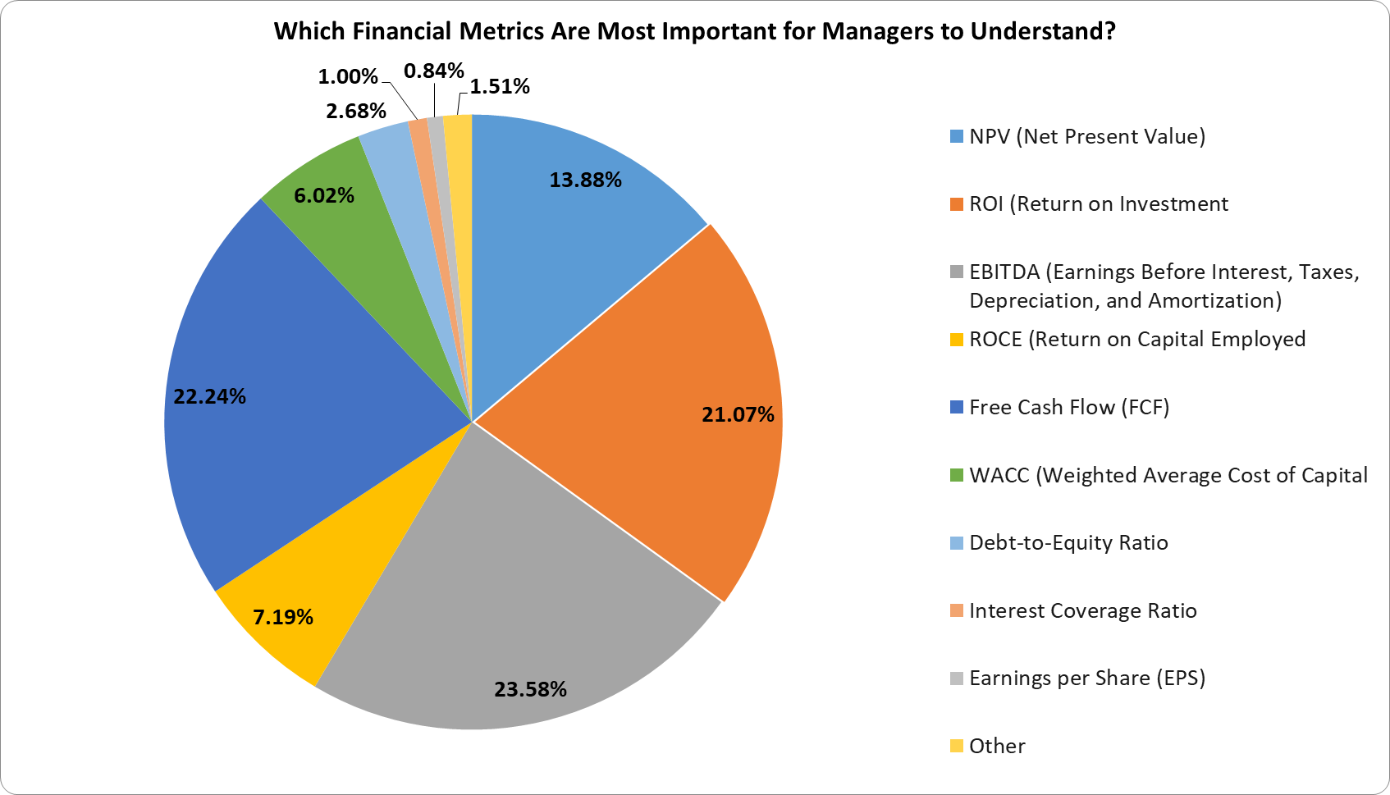
Which Financial Metrics Are Most Important for Managers to Understand?

Slide 17
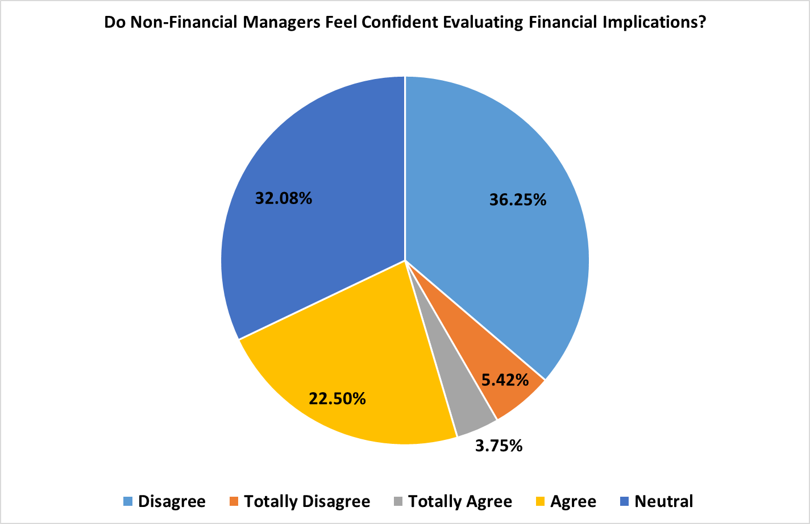
Do Non-Financial Managers Feel Confident Evaluating Financial Implications?

Slide 18
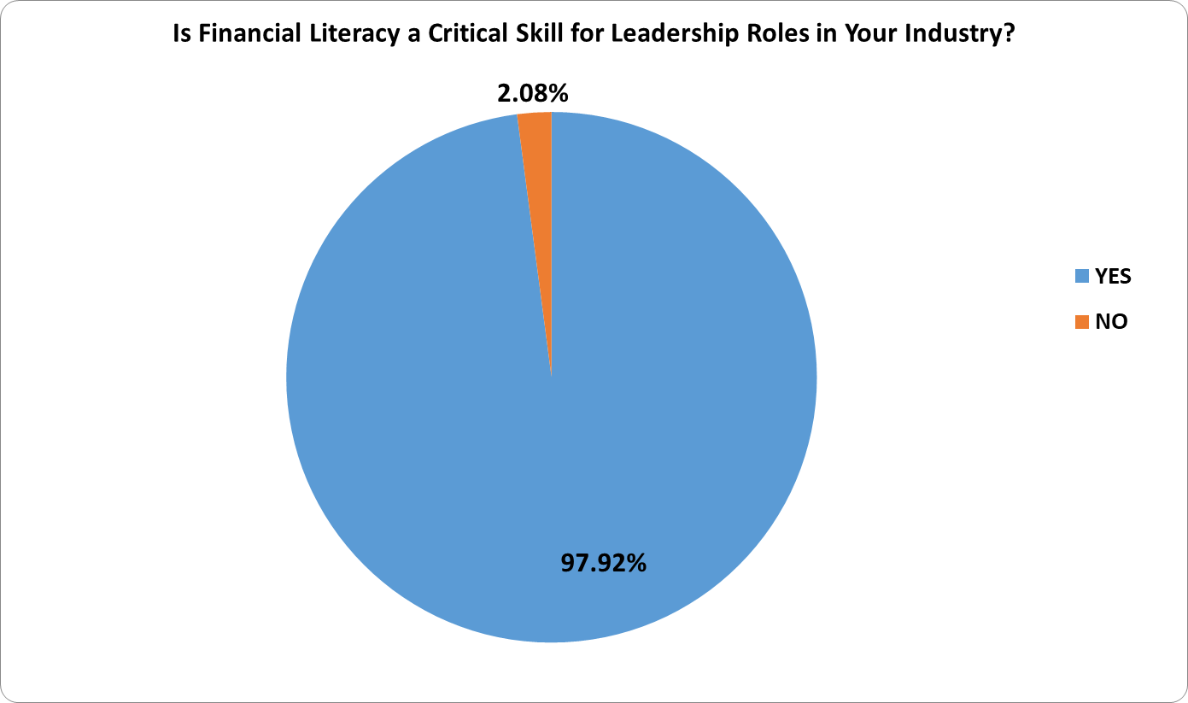
Is financial literacy important?

Slide 19
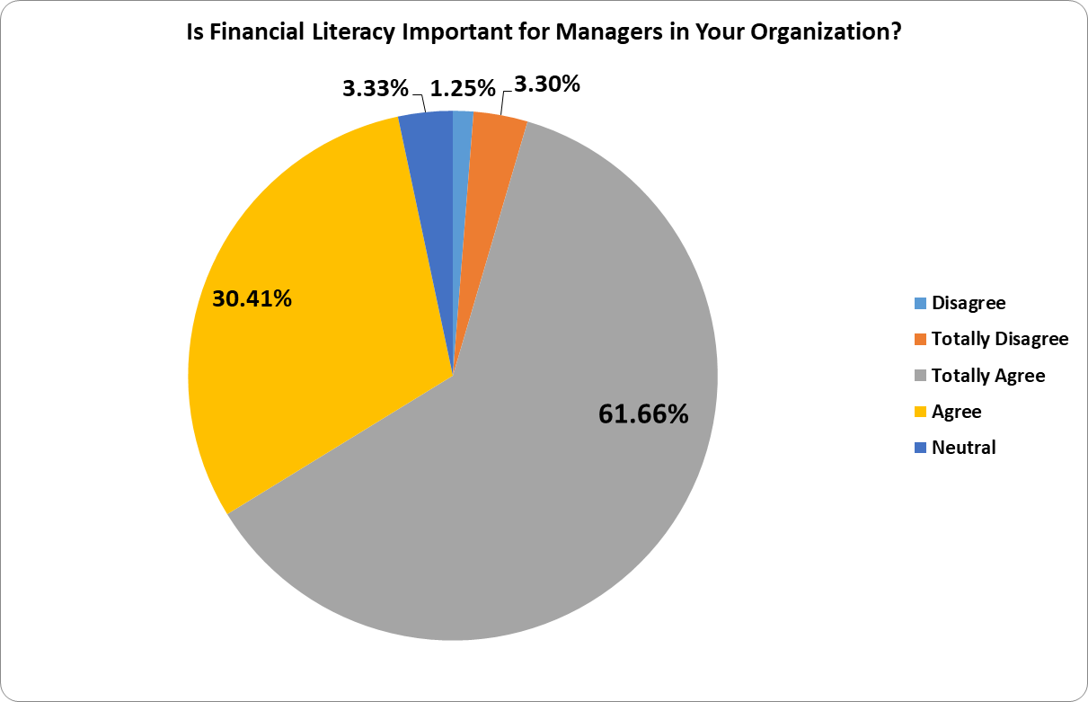
Is Financial Literacy Important for Managers in Your Organization?

Slide 20
Sub Sample Group Analysis

Slide 21
Category | Group 1 | % | Group 2 | %
Industry Category | Non-Finance | 82.92% | Finance | 17.08%
Company Size Category | Large | 65.42% | SME | 34.58%
Role Category | Non-Executive | 55.42% | Executive | 44.58%
Department Category | Non-Finance | 70.83% | Finance | 29.17%
Capital Status Category | Private | 60.00% | Public | 40.00%

Slide 22
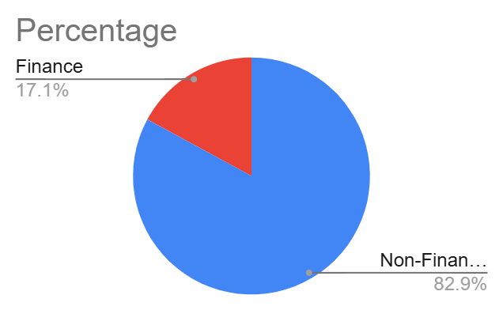
Group By Sector
Industry Category | Percentage
Non-Finance | 82.92
Finance | 17.08

Slide 23
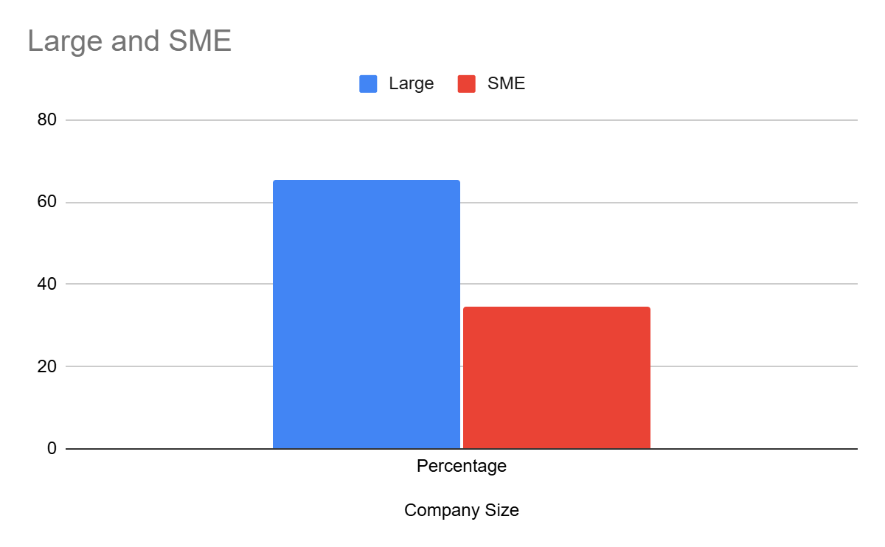
Group By Company Size
Company Size | Large | SME
Percentage | 65.42 | 34.58

Slide 24
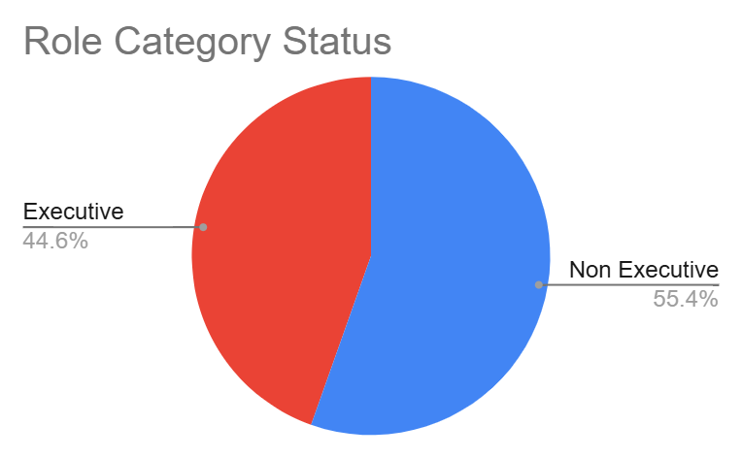
Group By Role
Role Category | Non Executive | Executive
Percentage | 55.42 | 44.58

Slide 25
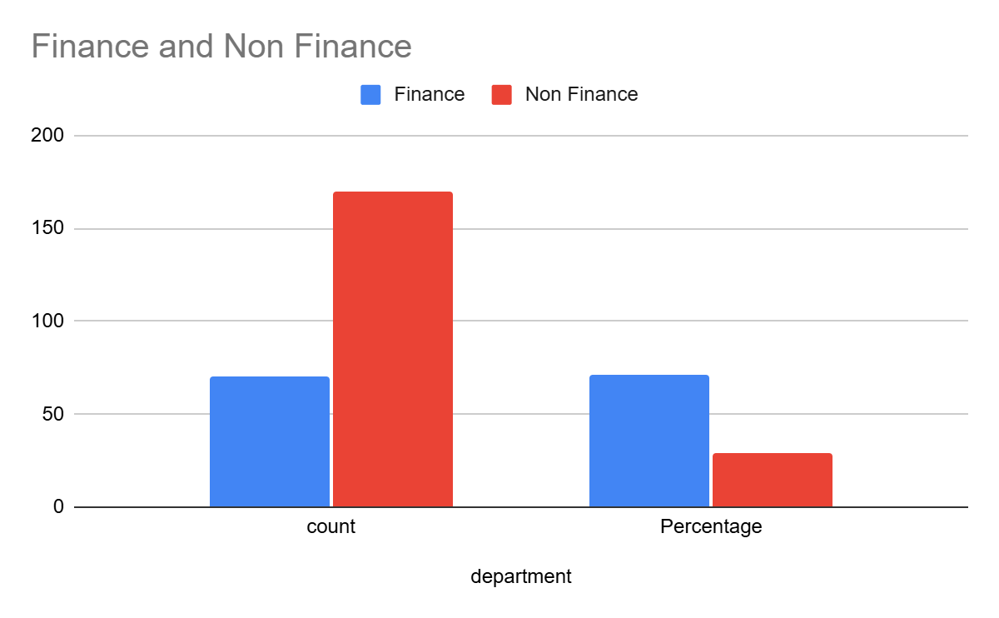
Group By Department
department | Finance | Non Finance
count | 70 | 170
Percentage | 70.83 | 29.17

Slide 26
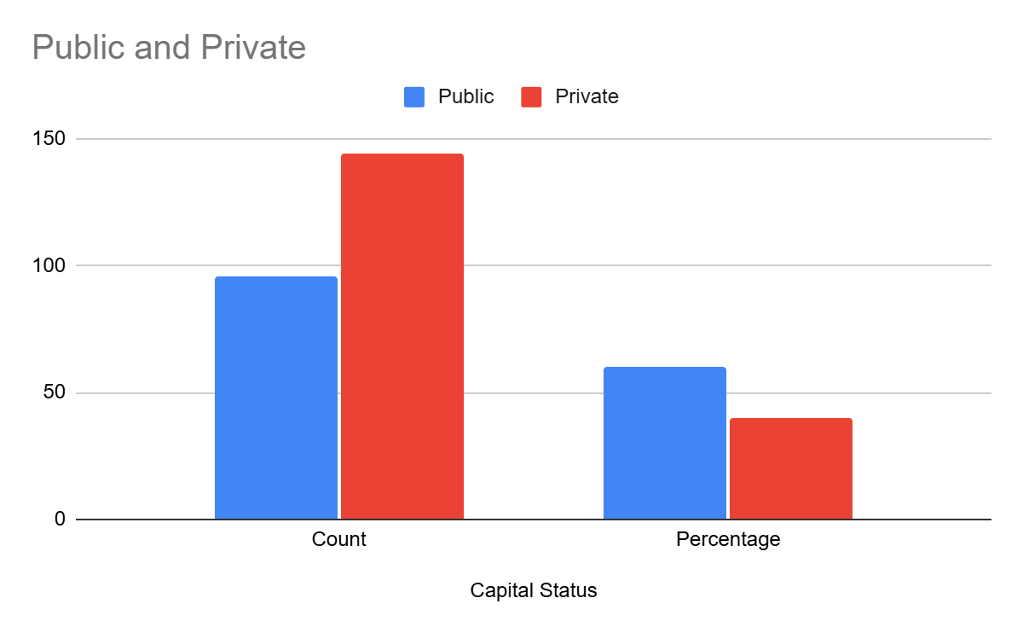
Group By Capital Status
Capital Status | Public | Private
Count | 96 | 144
Percentage | 60 | 40

Slide 27
Correlation Analysis

Slide 28
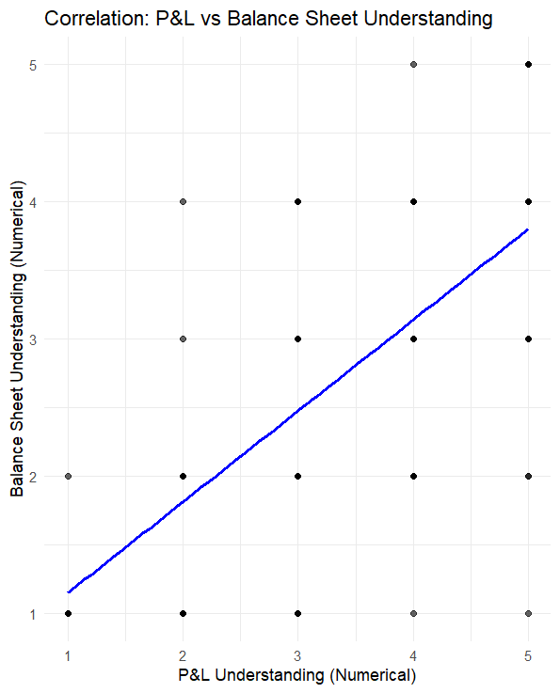
Correlation #1: P&L vs Balance Sheet Understanding
Pair | r | p‑value | Strength
P&L vs Balance‑Sheet Understanding | 0.63 | 1.16 × 10⁻²⁷ | Strong
Notes:
Interpretation & Significance:
Equally robust (r = 0.63, p < 0.001): deeper familiarity with revenues & expenses co‑varies strongly with understanding of how they flow into assets and liabilities. Integrating P&L and balance‑sheet teaching is likely to compound learning gains.

Slide 29
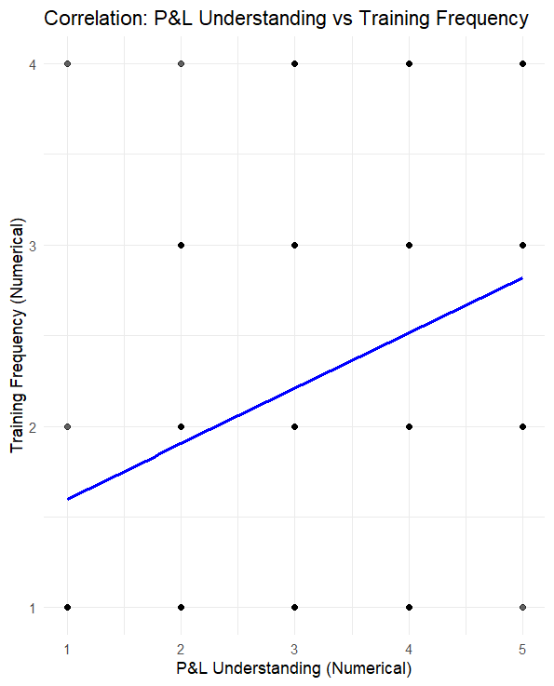
Correlation #2: P&L Understanding vs Training Frequency
Pair | r | p‑value | Strength
P&L Understanding vs Training Frequency | 0.35 | 2.67 × 10⁻⁸ | Moderate–Weak
Notes:
Interpretation & Significance:
A weak‑to‑moderate correlation (r = 0.35, p < 0.001). Simply increasing the number of P&L training sessions has only a modest impact on self‑rated P&L comprehension. Quality, interactivity, and contextual application of training probably matter more than count.

Slide 30
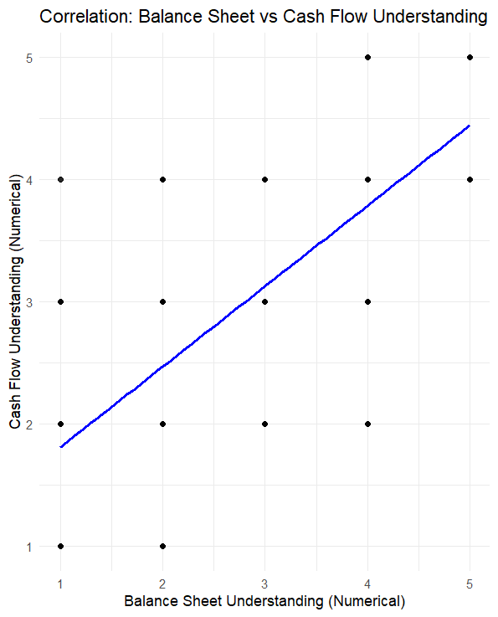
Correlation #3: Balance Sheet vs Cash Flow Understanding
Pair | r | p‑value | Strength
Balance‑Sheet vs Cash‑Flow Understanding | 0.67 | 1.78 × 10⁻³² | Strong
Notes:
Interpretation & Significance:
A strong, highly significant link (r = 0.67, p < 0.001) showing that as managers’ self‑rated balance‑sheet knowledge increases, so does their grasp of cash‑flow mechanics. These statements are conceptually intertwined, so learning one boosts the other.

Slide 31
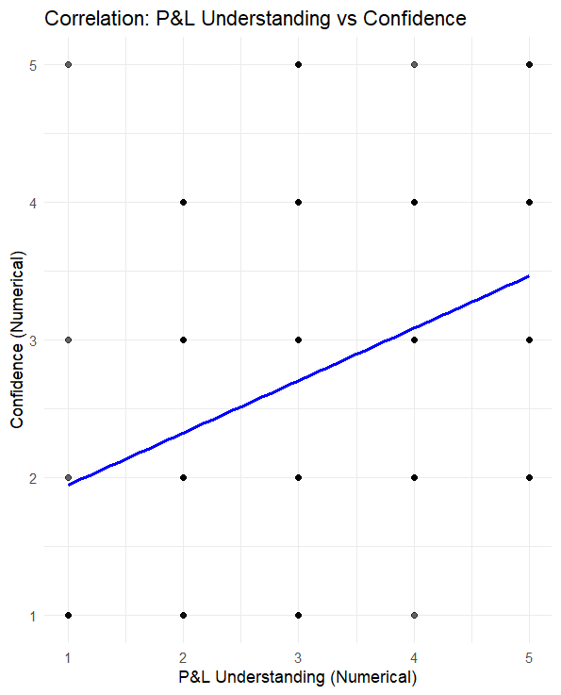
Correlation #4: P&L Understanding vs Confidence
Pair | r | p‑value | Strength
P&L Understanding vs Confidence | 0.39 | 4.48 × 10⁻¹⁰ | Moderate
Notes:
Interpretation & Significance:
A moderate but significant relationship (r = 0.39, p < 0.001). Knowing the income statement does translate into confidence in using financials, but only modestly—indicating that conceptual knowledge alone isn’t enough to fully build self‑efficacy.

Slide 32
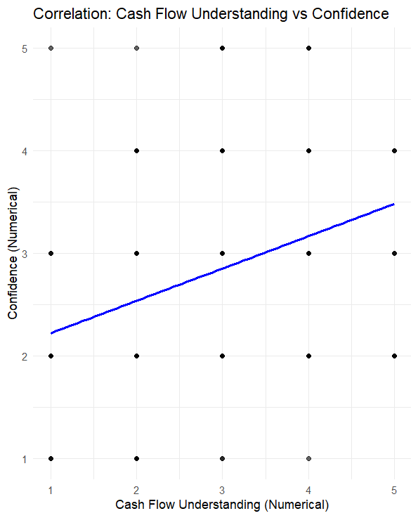
Correlation #5: Cash Flow Understanding vs Confidence
Pair | r | p‑value | Strength
Cash‑Flow Understanding vs Confidence | 0.33 | 1.10 × 10⁻⁷ | Moderate–Weak
Notes:
Interpretation & Significance:
Also a modest link (r = 0.33, p < 0.001). Even when cash‑flow concepts are understood, many managers still don’t feel fully confident—underscoring the need for hands‑on practice (e.g. live modeling, real‑data exercises) to bridge the gap from “know” to “do.”

Slide 33
Correlations performed between various columns
Correlation Pair | Original Column 1 (from Raw Data) | Original Column 2 (from Raw Data) | Variables Involved | Reasoning
Understanding of Balance Sheet and Understanding of Cash Flows | Managers in my organization have a strong understanding of the balance sheet, including capital and funding | Managers in my organization have a strong understanding of cash flows | Balance Sheet Understanding (Numerical) and Cash Flow Understanding (Numerical) | A strong understanding of the balance sheet is fundamentally linked to understanding cash flows, as changes in balance sheet items directly impact the statement of cash flows. Proficiency in one often indicates proficiency in the other.
Understanding of P&L or Income Statement and Understanding of Balance Sheet | Managers in my organization have a strong understanding of P&L or income statement. | Managers in my organization have a strong understanding of the balance sheet, including capital and funding | P&L Understanding (Numerical) and Balance Sheet Understanding (Numerical) | The P&L and balance sheet are closely related primary financial statements. The profit or loss impacts the equity section of the balance sheet, making understanding of one beneficial for understanding the other.
Understanding of P&L or Income Statement and Confidence in Evaluating Financial Implications | Managers in my organization have a strong understanding of P&L or income statement. | Non-financial managers in my organization feel confident when evaluating the financial implications of decisions. | P&L Understanding (Numerical) and Confidence (Numerical) | Managers who understand the P&L are better equipped to assess the financial outcomes of their decisions, leading to increased confidence in making those decisions.
Understanding of P&L or Income Statement and Frequency of Financial Literacy Training | Managers in my organization have a strong understanding of P&L or income statement. | How often does your organization offer training to improve managers financial literacy? | P&L Understanding (Numerical) and Training Frequency (Numerical) | This suggests that organizations providing more frequent financial literacy training have managers with a better understanding of the P&L statement, indicating the potential effectiveness of training.
Understanding of Cash Flows and Confidence in Evaluating Financial Implications | Managers in my organization have a strong understanding of cash flows | Non-financial managers in my organization have a strong understanding of the financial implications of decisions. | Cash Flow Understanding (Numerical) and Confidence (Numerical) | Understanding cash flow is crucial for evaluating the liquidity and sustainability of decisions. Managers who understand cash flow can better predict financial impact, leading to greater confidence in decision-making.

Slide 34
Columns recoding key used for correlation analysis
Original Column Name (from Raw Data) | New Numerical Column Name (used in R script)
Non-financial managers in my organization feel confident when evaluating the financial implications of decisions. | Confidence (Numerical)
Managers in my organization have a strong understanding of P&L or income statement. | P&L Understanding (Numerical)
Managers in my organization have a strong understanding of the balance sheet, including capital and funding | Balance Sheet Understanding (Numerical)
Managers in my organization have a strong understanding of cash flows | Cash Flow Understanding (Numerical)
How often does your organization offer training to improve managers financial literacy? | Training Frequency (Numerical)

